Slide 1
MACHINE LEARNING • DATA SCIENCE
Feature Extraction &
Mobile Phone Price Prediction
A data-driven approach to understanding the specifications that influence mobile phone prices.
PROJECT PRESENTATION
Dataset: 541 mobile phone records | Models: 4 regressors
01 / 16

Slide 2
01 • INTRODUCTION
Project overview
Business context
Project objective
Expected value
A mobile retailer wants to understand which product specifications are associated with selling price.
Build a regression model to estimate phone price and identify influential features.
Support price positioning, product comparisons and marketing decisions with evidence.
Core question
“Which mobile phone features matter most when estimating its market price?”
MOBILE PRICE PREDICTION • MACHINE LEARNING PROJECT
02 / 16

Slide 3
02 • PROJECT FRAMING
Problem statement & objectives
• Mobile phones differ across storage, RAM, battery, cameras, processor, design and other specifications.
• Manual pricing based only on a few specifications can overlook patterns across the product range.
• Use historical product data to learn relationships between specifications and the listed price.
• Compare multiple regression algorithms and interpret feature importance to derive practical recommendations.
Target variable
Prize — the price field in the supplied dataset (currency symbol/commas removed in the notebook).
MOBILE PRICE PREDICTION • MACHINE LEARNING PROJECT
03 / 16

Slide 4
03 • DATA UNDERSTANDING
Dataset at a glance
541
12
187
275
records
columns
unique models
unique colours
FEATURES IN THE SOURCE DATA
• Product identity: Model, Colour
• Core specifications: Memory, RAM, Battery_
• Imaging: Rear Camera, Front Camera, AI Lens
• Hardware/design: Processor_, Mobile Height
• Target: Prize
Data source
Processed_Flipdata CSV supplied with the project. It contains 541 rows and 12 columns; the first column is an index-like field named “Unnamed: 0”.
MOBILE PRICE PREDICTION • MACHINE LEARNING PROJECT
04 / 16

Slide 5
04 • DATA EXPLORATION
Exploratory data analysis
Completeness
Duplicates
Data types
The CSV reports 0 missing values across all 12 columns.
The notebook output reports 0 duplicate rows.
Numeric, categorical and text-formatted fields are mixed.
Selected descriptive statistics
• Memory: median 128 GB; range 16–256 GB.
• RAM: median 6 GB; range 2–8 GB.
• Battery_: median 5,000 mAh; range 800–7,000 mAh.
• Front camera: most frequent value 16MP; rear camera: most frequent value 50MP.
MOBILE PRICE PREDICTION • MACHINE LEARNING PROJECT
05 / 16

Slide 6
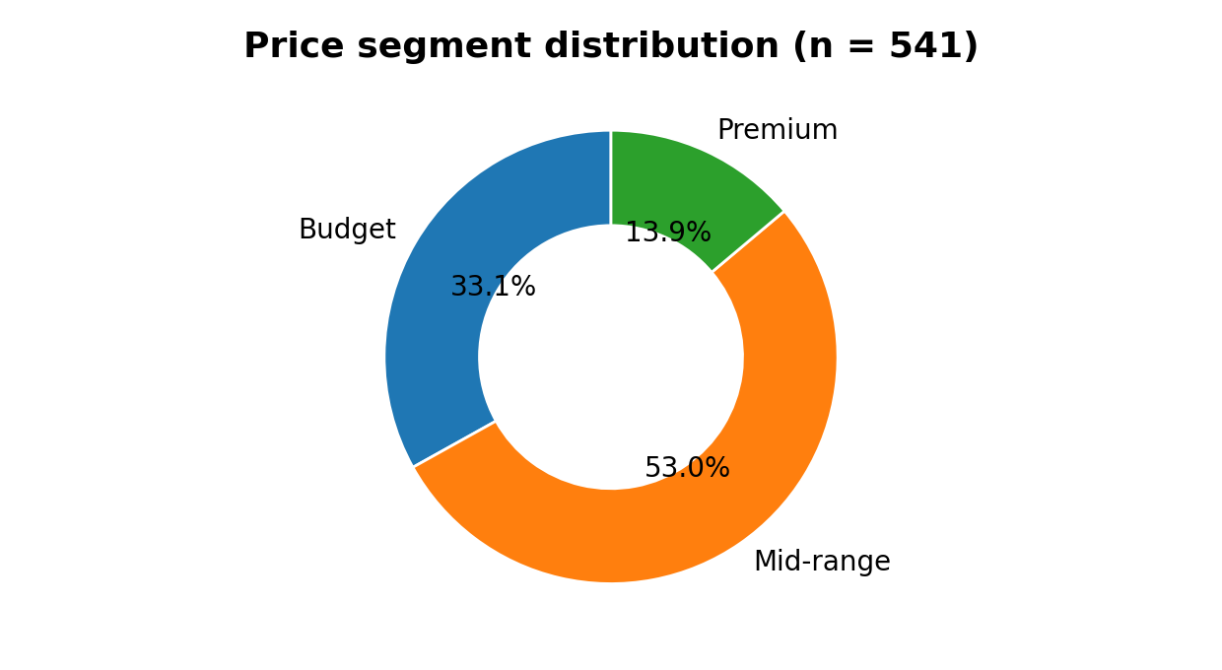
05 • TARGET DISTRIBUTION
Price segments in the dataset
Budget
179 records • price up to ₹10,000
Mid-range
287 records • ₹10,001–₹25,000
Premium
75 records • above ₹25,000
Mid-range is the largest segment (53.0%).
MOBILE PRICE PREDICTION • MACHINE LEARNING PROJECT
06 / 16

Slide 7
06 • PREPARATION
Data preprocessing workflow
• Loaded the processed CSV and inspected dimensions, data types, summary statistics and missing values.
• Removed duplicate rows (the source notebook found none).
• Cleaned the target price by removing non-numeric symbols and commas, then converting it to numeric.
• Used a regular expression to extract the first numeric value from object/text fields (for example, “13MP” → 13).
• Selected numeric predictors and filled remaining missing predictor/target values with medians in the model-building cells.
Important implementation note
The notebook describes one-hot encoding and IQR outlier removal in its narrative, but the visible model-building code does not implement those steps.
MOBILE PRICE PREDICTION • MACHINE LEARNING PROJECT
07 / 16

Slide 8
07 • FEATURE ENGINEERING
Feature extraction & selection
Correlation analysis
SelectKBest (f_regression)
Notebook output shows Memory (0.567) and RAM (0.532) as the strongest positive numeric correlations with Prize.
The top two scores are Memory (254.94) and RAM (212.80); remaining selected numeric features include index, height, AI Lens and battery.
What this stage contributes
• Reduces attention to the variables with stronger statistical association to price.
• Provides a first-pass ranking before training predictive models.
• The index-like “Unnamed: 0” field also scores in this run, so it should be checked for possible data-order leakage.
MOBILE PRICE PREDICTION • MACHINE LEARNING PROJECT
08 / 16

Slide 9
08 • MACHINE LEARNING
Model development
01
02
03
04
Prepare X and y
→
Train / test split
→
Fit regressors
→
Evaluate
Prize is target; numeric columns form X
80% training • 20% testing
Four algorithms trained
MAE • RMSE • R²
Algorithms evaluated
• Linear Regression
• Decision Tree Regressor
• Random Forest Regressor (100 trees in the initial training cell)
• Gradient Boosting Regressor
MOBILE PRICE PREDICTION • MACHINE LEARNING PROJECT
09 / 16

Slide 10
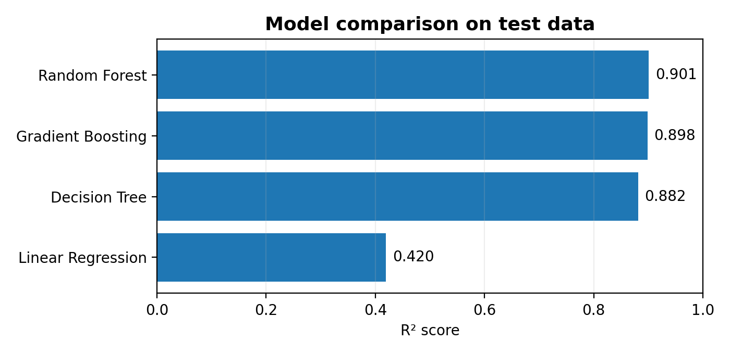
09 • PERFORMANCE
Model evaluation results
Best test R²
Random Forest • 0.901
Random Forest MAE
₹1,510.55
Random Forest RMSE
₹3,694.29
R² is the highest among the four models in the notebook output.
MOBILE PRICE PREDICTION • MACHINE LEARNING PROJECT
10 / 16

Slide 11
10 • BEST MODEL
Why Random Forest was selected
• Random Forest achieved the highest reported test R²: 0.90098.
• Gradient Boosting was close behind at R² = 0.89838.
• Decision Tree achieved R² = 0.88150.
• Linear Regression scored R² = 0.41950, indicating weaker fit for this dataset and feature representation.
• Random Forest was used for the feature-importance analysis shown in the supplied chart.
Interpretation
The model explains about 90.1% of the variance in test-set prices for this particular split; this is not a guarantee of performance on new market data.
MOBILE PRICE PREDICTION • MACHINE LEARNING PROJECT
11 / 16

Slide 12
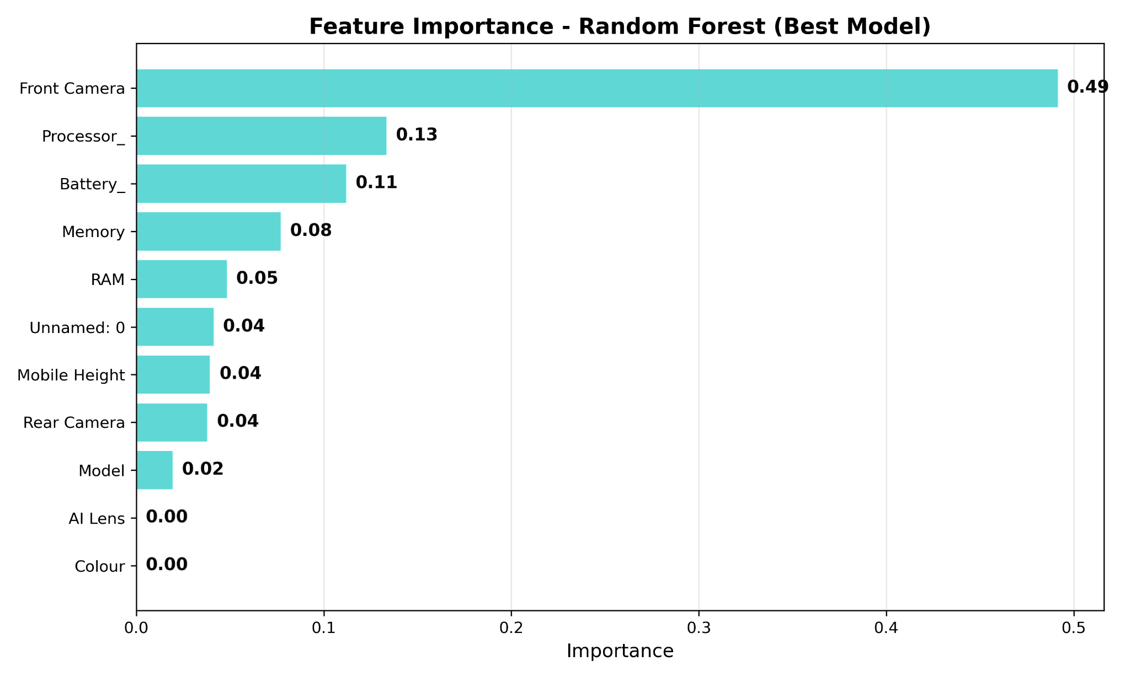
11 • MODEL INTERPRETATION
Feature importance — Random Forest
Top feature
Front Camera • 0.492 (49.2%)
Next drivers
Processor_ • 13.3%
Battery_ • 11.2%
Other features
Memory • 7.7%
RAM • 4.8%
Feature importance reflects the fitted forest's split-based contribution, not causation.
MOBILE PRICE PREDICTION • MACHINE LEARNING PROJECT
12 / 16

Slide 13
12 • FINDINGS
What the feature ranking tells us
• Front Camera dominates the fitted Random Forest importance ranking (approximately 49.2%).
• Processor_ (13.3%) and Battery_ (11.2%) are the next strongest contributors.
• Memory (7.7%) and RAM (4.8%) have smaller importance in this model run.
• Model, AI Lens and Colour have very low or no measurable importance in the displayed chart.
• The ranking differs from the notebook's separate correlation / SelectKBest outputs; these techniques measure different relationships.
Critical interpretation
Importance is model- and data-preparation-dependent. It should not be read as proof that a feature causes a higher price.
MOBILE PRICE PREDICTION • MACHINE LEARNING PROJECT
13 / 16

Slide 14
13 • BUSINESS IMPLICATIONS
Recommendations for the retailer
1. Validate camera positioning
2. Track processor tiers
The fitted model gives Front Camera the largest importance. Check whether this reflects genuine pricing patterns or numeric extraction / data-order effects.
Processor_ ranks second. Create consistent processor categories and compare price bands before setting premiums.
3. Review battery & storage
4. Build a repeatable pricing tool
Battery_ and Memory contribute in the model. Compare like-for-like devices to estimate practical price differences.
Use the model as a decision-support estimate, then validate predictions against current market prices and competitor offers.
MOBILE PRICE PREDICTION • MACHINE LEARNING PROJECT
14 / 16

Slide 15
14 • CRITICAL REVIEW
Limitations & next improvements
• Text-to-number extraction takes only the first number; processor names can become misleading numeric codes and camera strings lose context.
• The notebook selects numeric columns and does not visibly one-hot encode Model, Colour or Processor_ in the model pipeline.
• “Unnamed: 0” is an index-like feature and may encode row/order information; test models with it removed.
• The supplied chart and notebook narrative contain different feature-importance claims; this presentation uses the executed Random Forest output and uploaded chart.
• Improve validation with cross-validation, a clean preprocessing pipeline, categorical encoding, outlier review and an untouched holdout set.
Next experiment
Rebuild the pipeline using ColumnTransformer + OneHotEncoder for categorical fields and compare metrics after removing the index column.
MOBILE PRICE PREDICTION • MACHINE LEARNING PROJECT
15 / 16

Slide 16
15 • CONCLUSION
From specifications to smarter pricing
The project demonstrates an end-to-end workflow: explore the product data, prepare features, train regression models, evaluate performance and interpret feature importance.
541
4
0.901
phone records
regression models
best test R²
Thank you • Questions & discussion
16 / 16

